Slide 1
Non-Local Means Inpainting of
MS Lesions in Longitudinal
Image Processing
Swadha Sanghvi (16D070037)
Arpit Singh (150070059)

Slide 2
Criminisi’s Inpainting Algorithm
“Onion-peel strategy”: Inpainting is done from outside to inside.
Requires a target patch to be given.

Slide 3

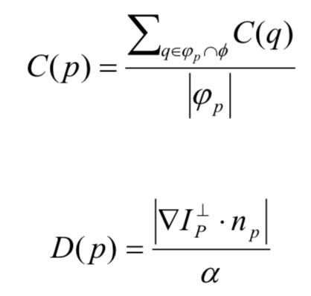
Step 1
Given a target region, a priority (P) is assigned to each pixel.
Initially, all points in the target region have a confidence (C) of 0.
Image Inpainting Based on a Novel Criminisi Algorithm by SONG Yuheng, YAN Hao

Slide 4
Step 2
Detect the boundary of the lesion region.
Find a pixel on the boundary with the highest priority
Search the neighbourhood for a pixel with the most similar surrounding (patch-distance).
Assign the known pixel to the unknown pixel.

Slide 5
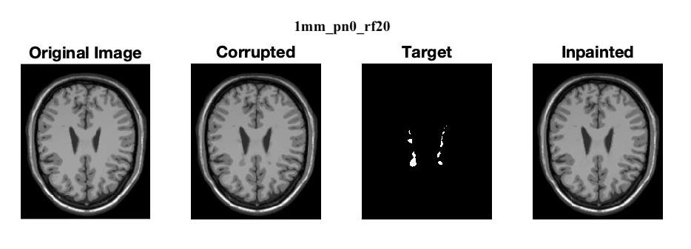
Inpainting on MS lesions

Slide 6
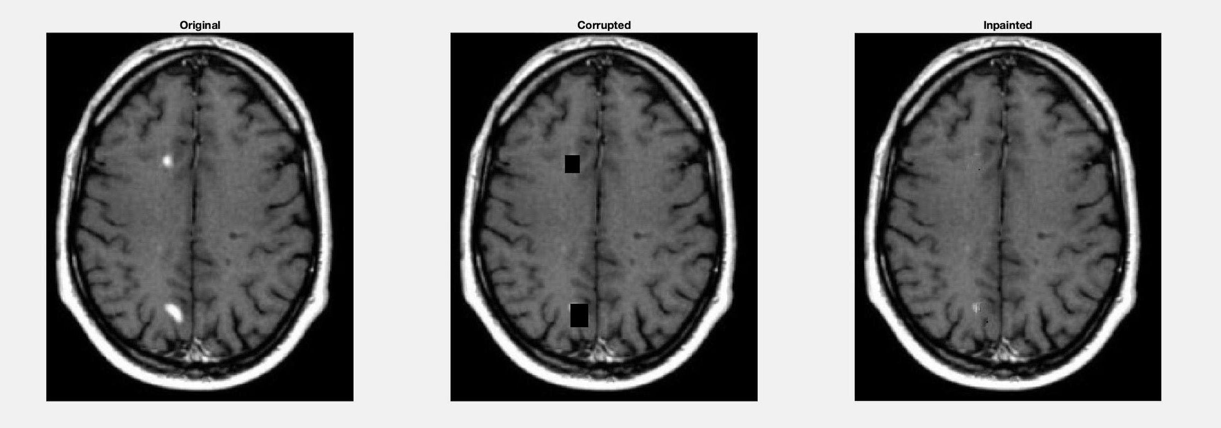
Inpainting on MS lesions

Slide 7
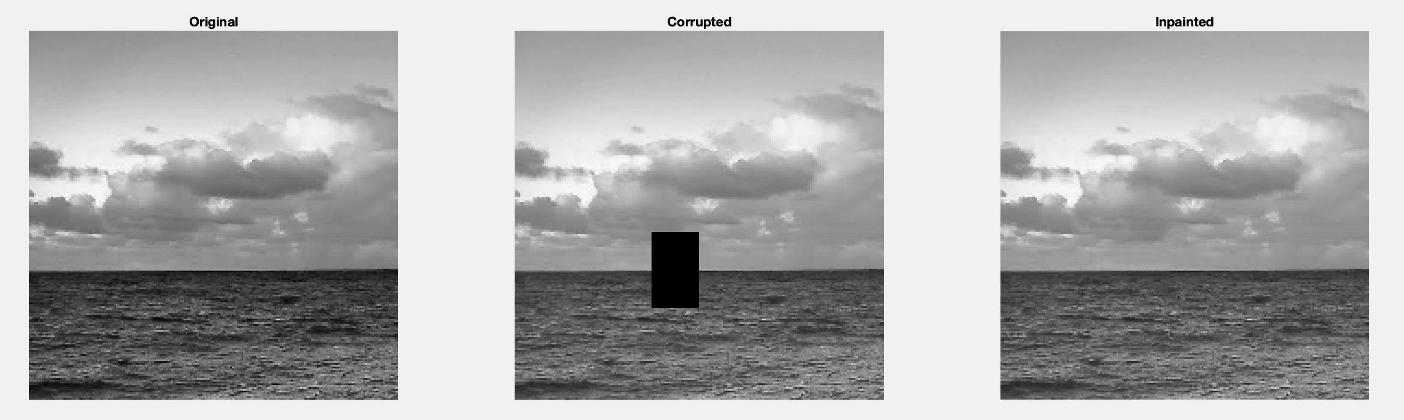
Inpainting on Non-Medical Images

Slide 8
Thank You

